Slide 1
LyfeLine
Elick Coval
Duyen Tran
Liam O’Donnell

Slide 2
Create an app to be used by both Emergency First Responders and victims of natural disasters
Victims will communicate to EMT that they need help
EMT can track and monitor victim’s location
Goals

Slide 3
Firebase Google’s mobile applications development platform
User Authentication
Firestore Database

Slide 4
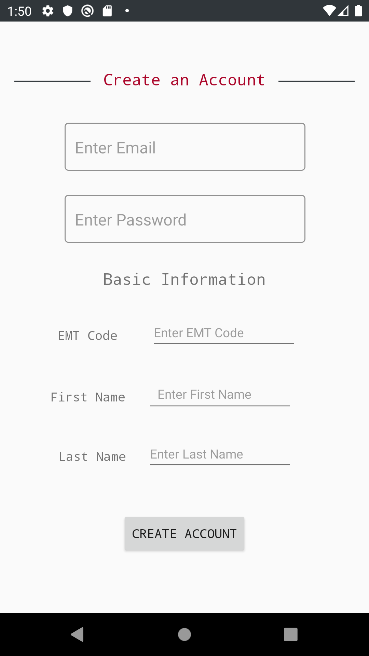
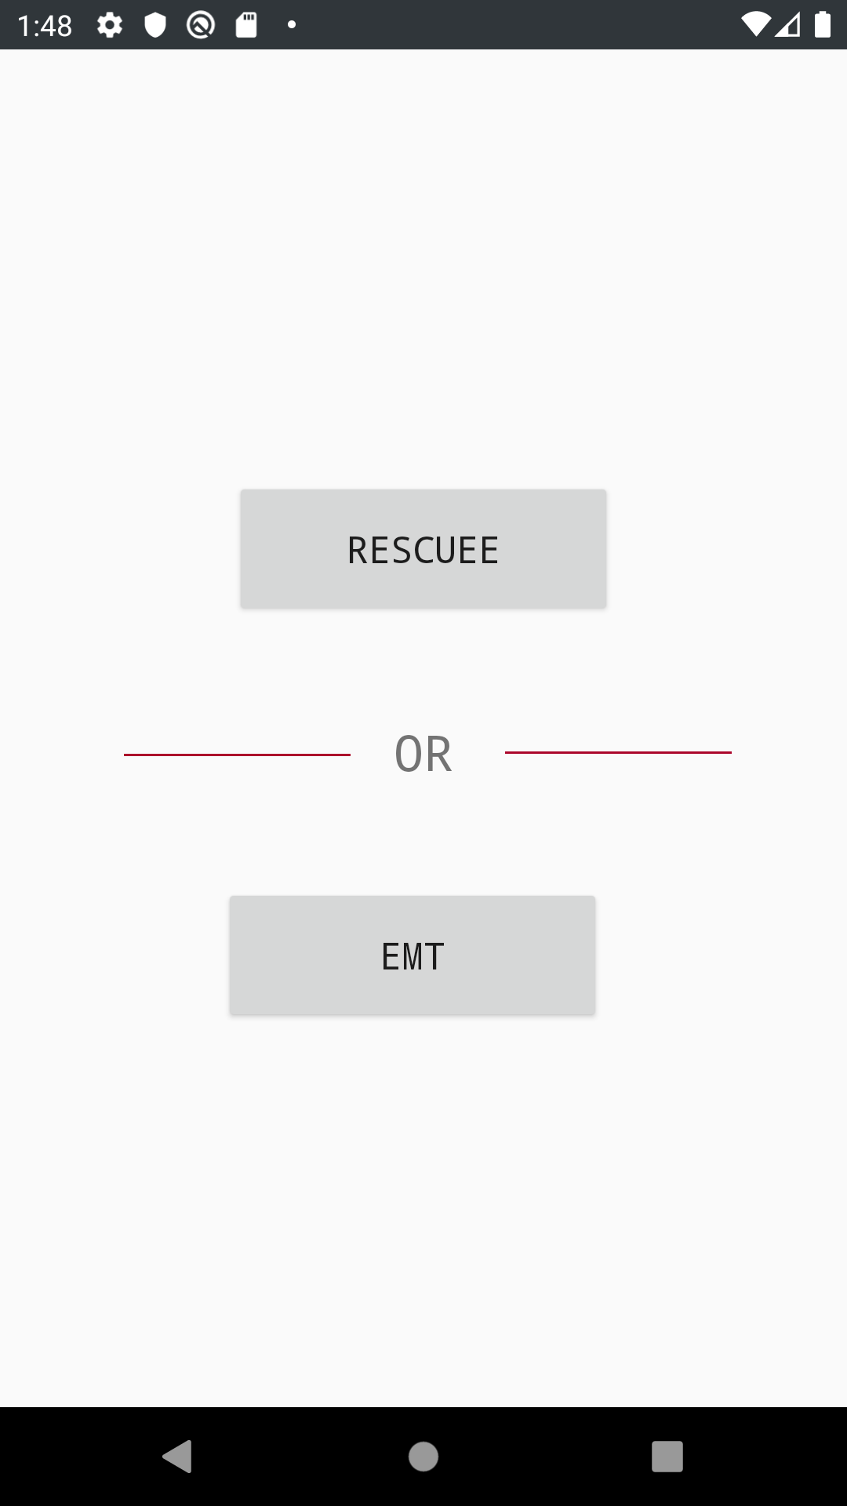
User authentication
Secure email and password
authentication system
Provides every user with a unique ID which helps us personalize the app for each user

Slide 5
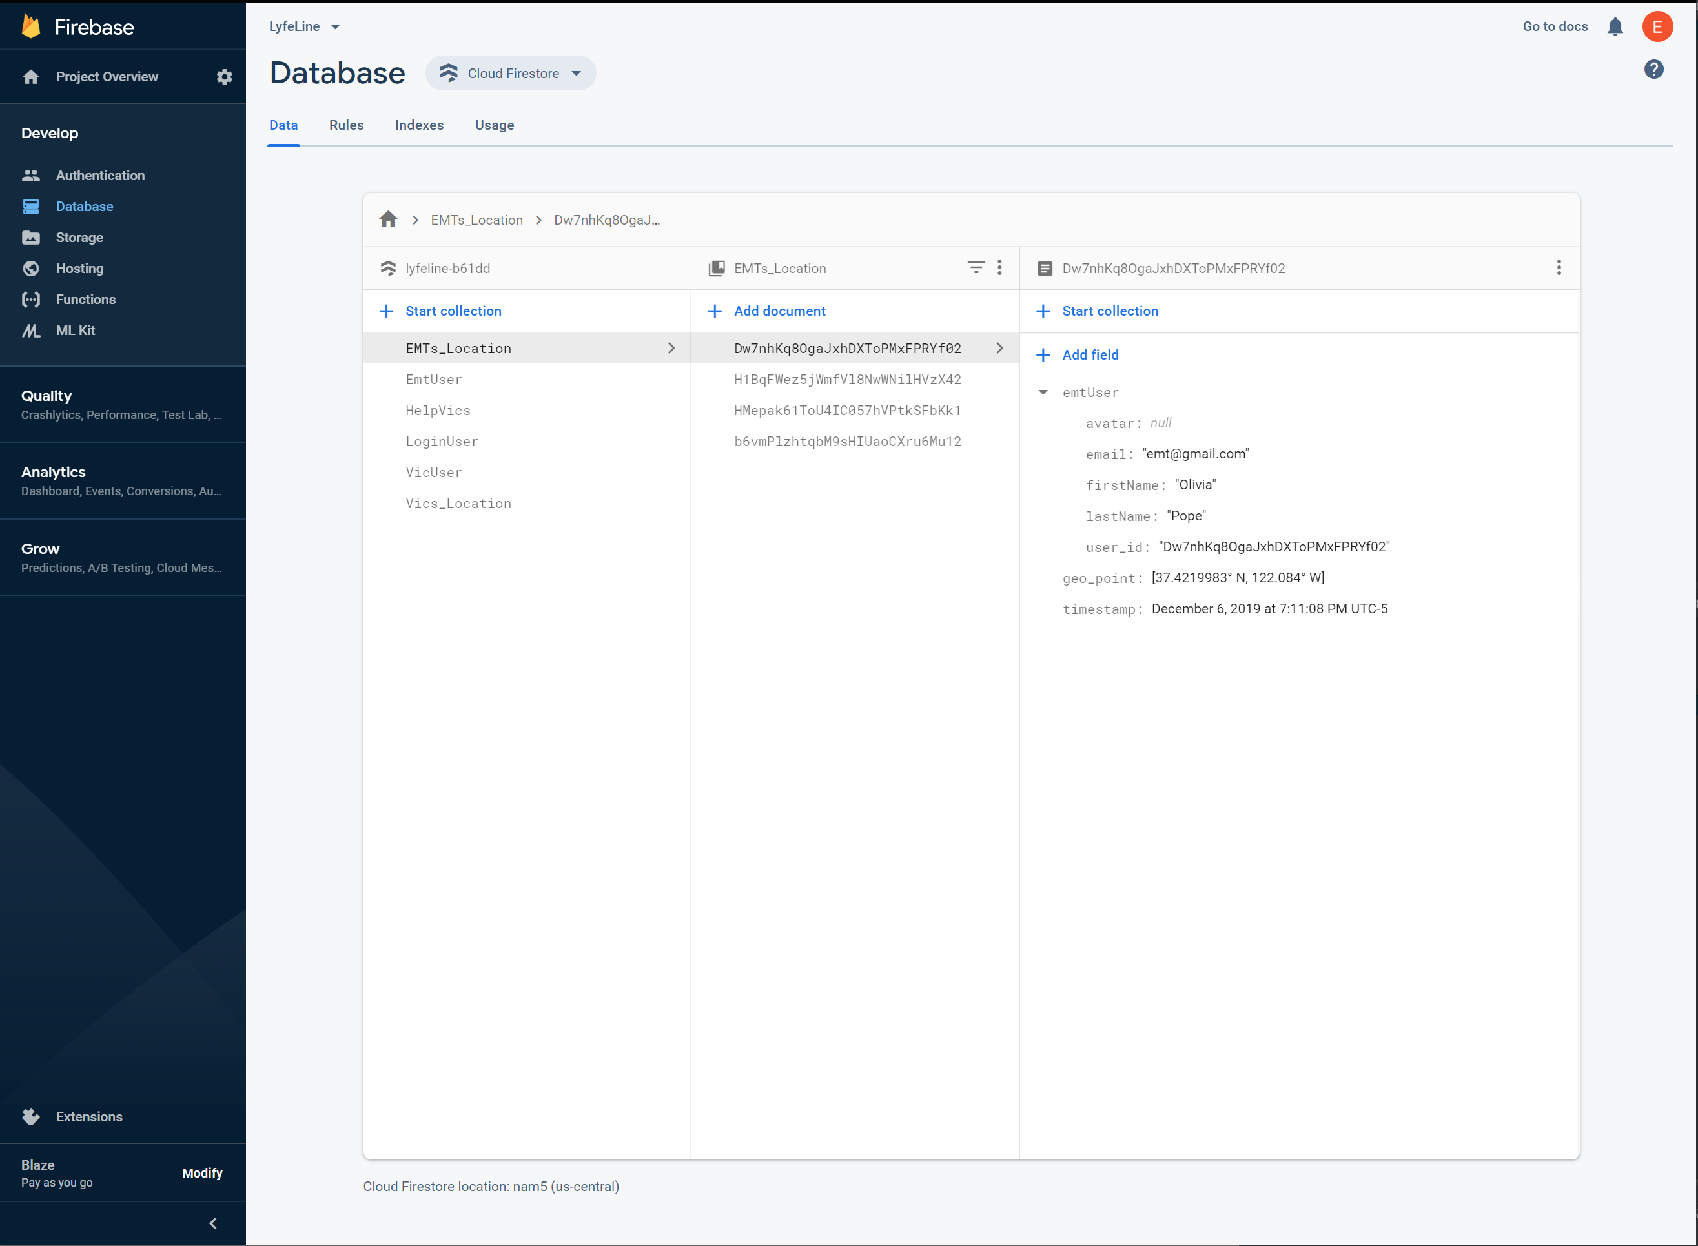
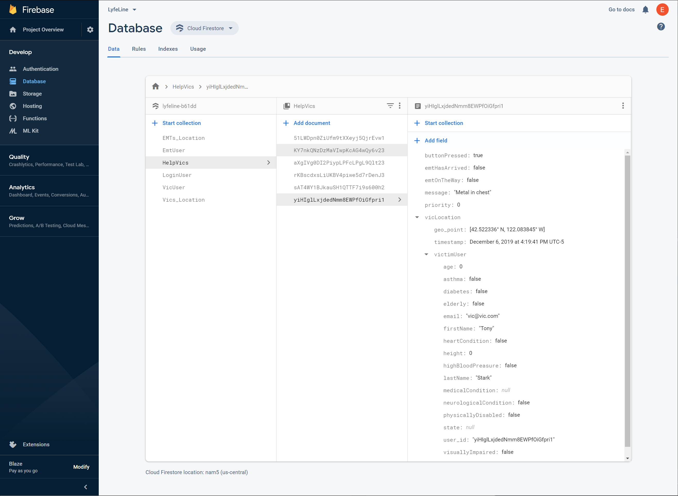
Cloud Firestore

Slide 6
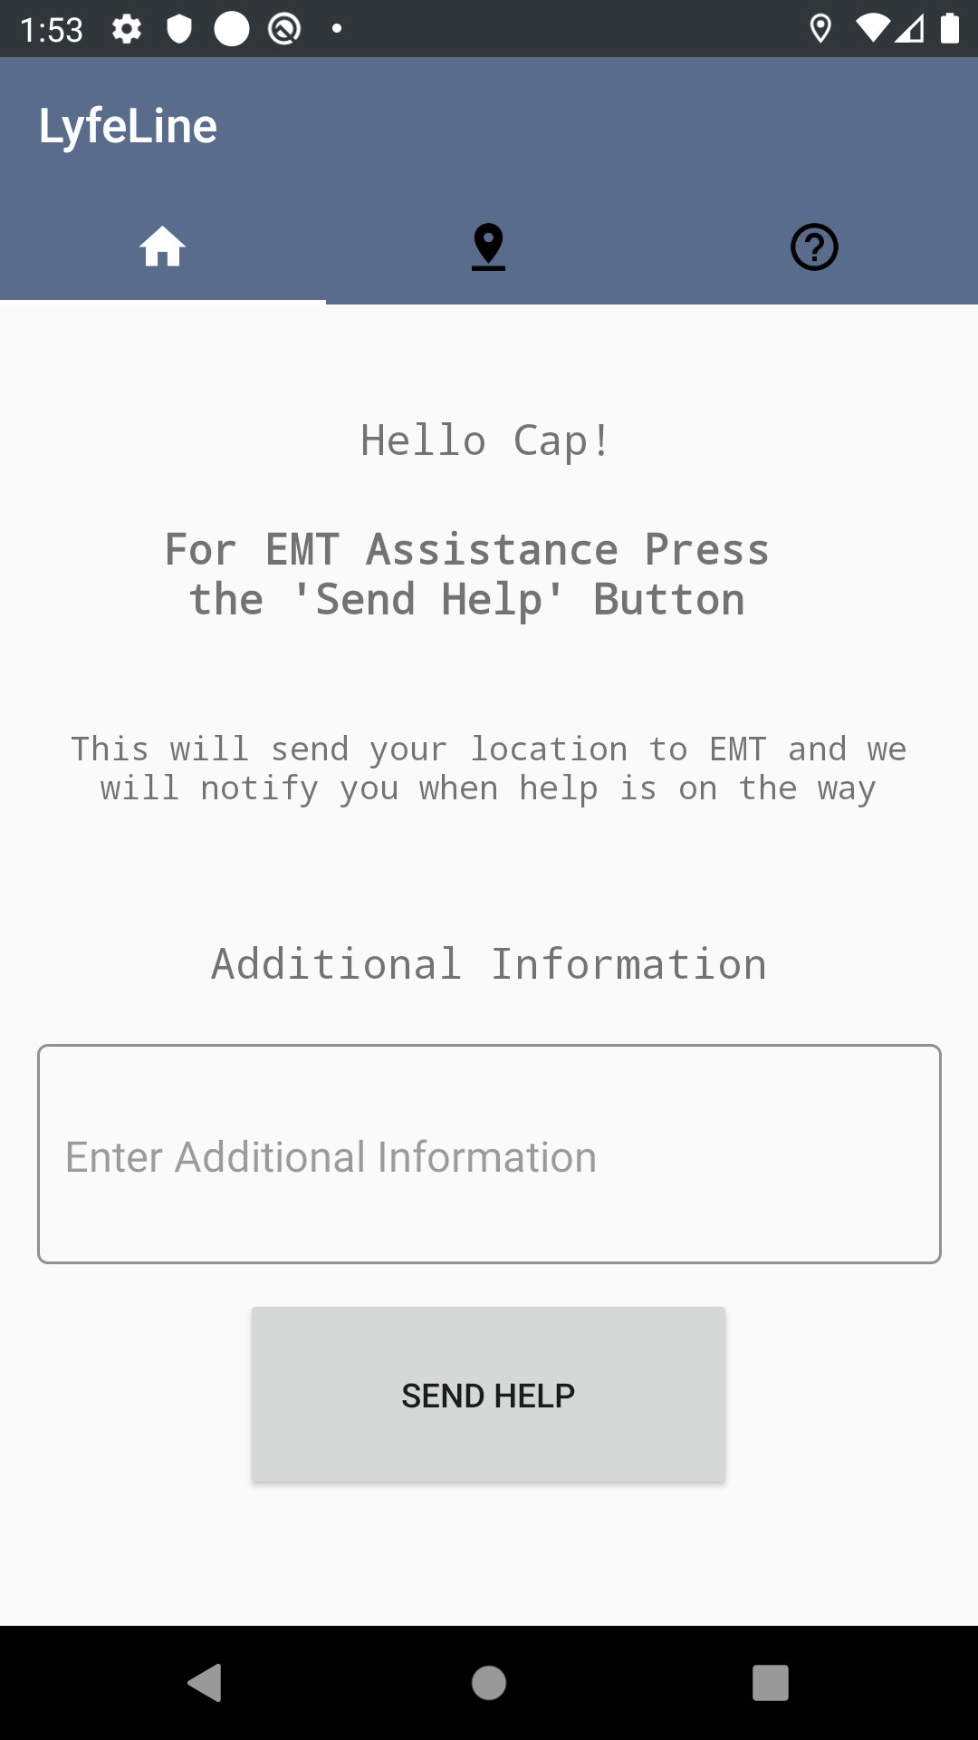
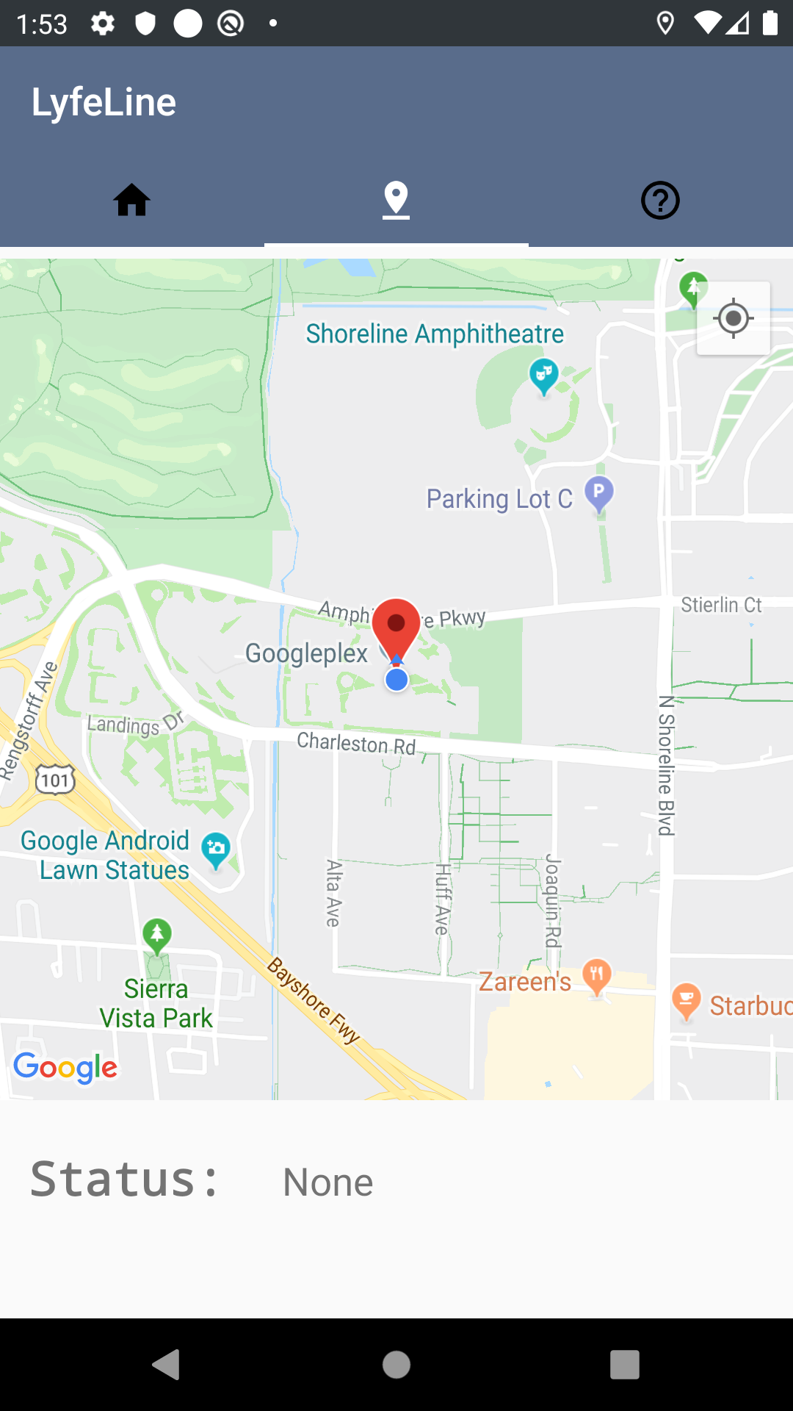
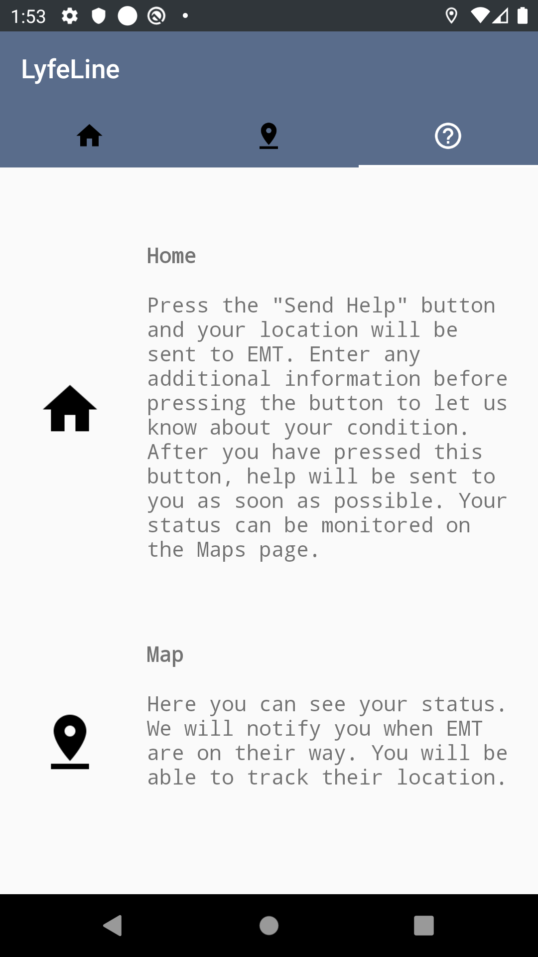
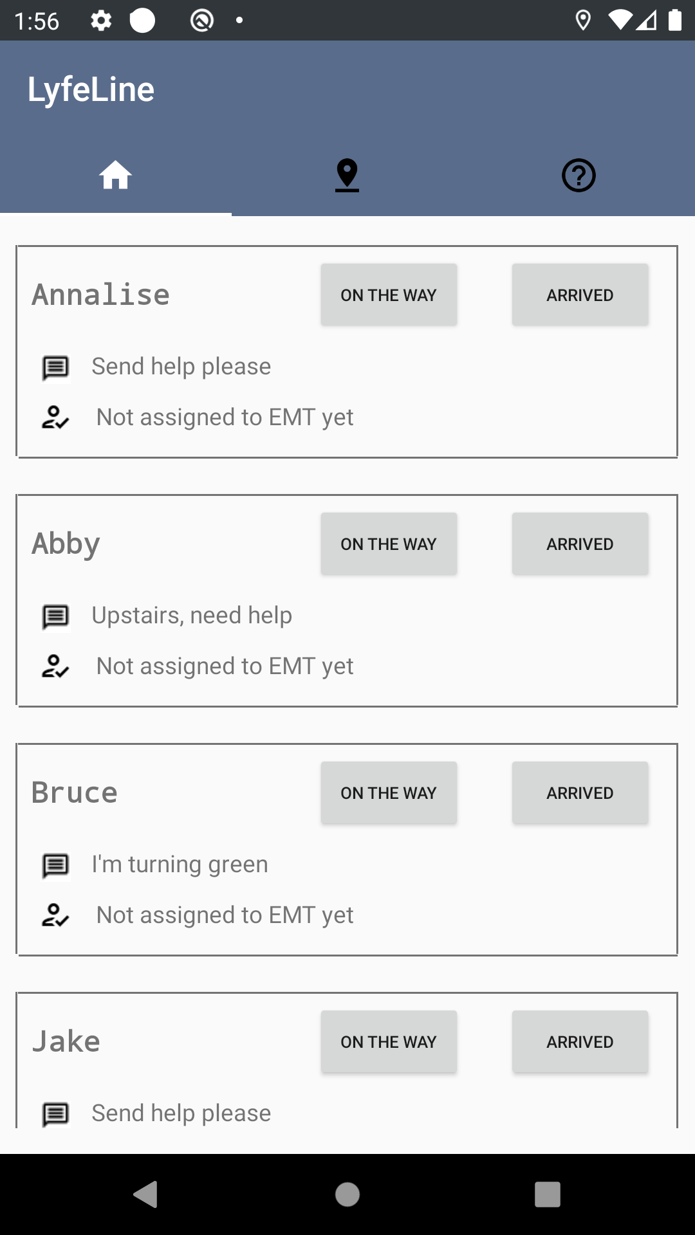
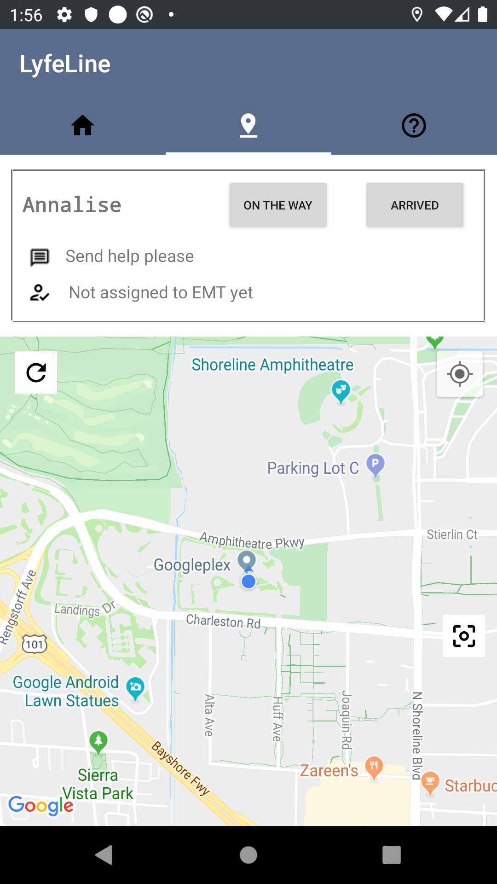
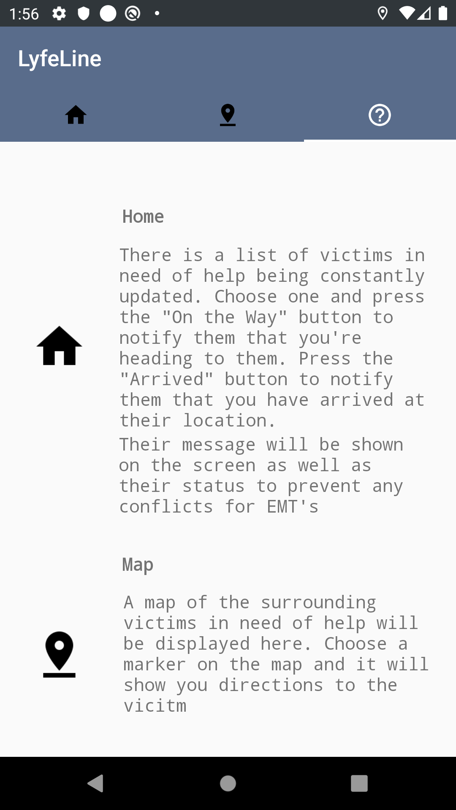
Victim Tabs
EMT Tabs

Slide 7
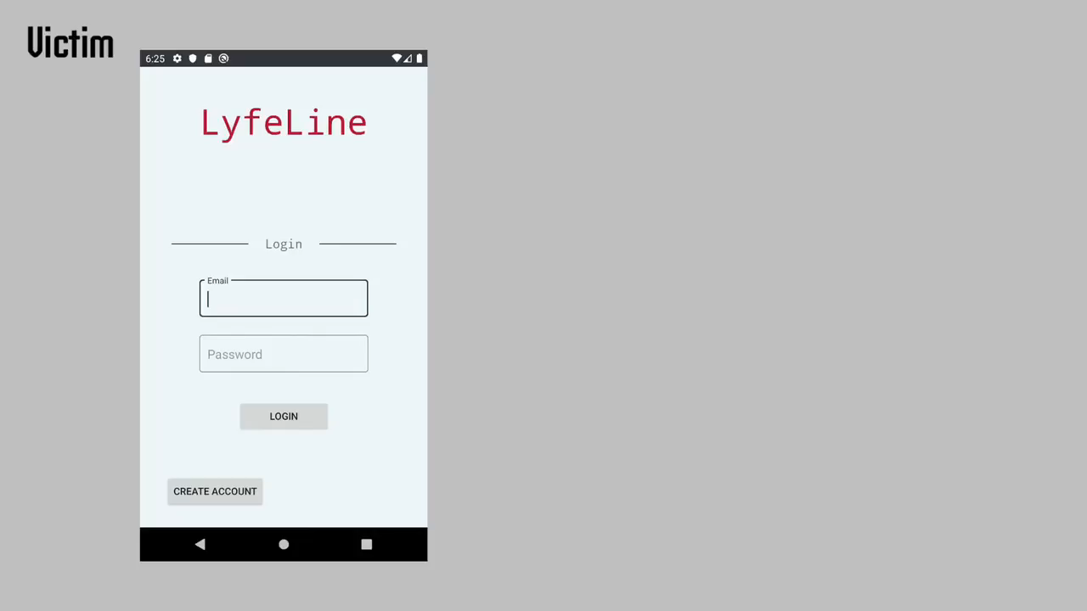

Slide 8
Google API’s
Maps
Directions
Fused Location Client

Slide 9
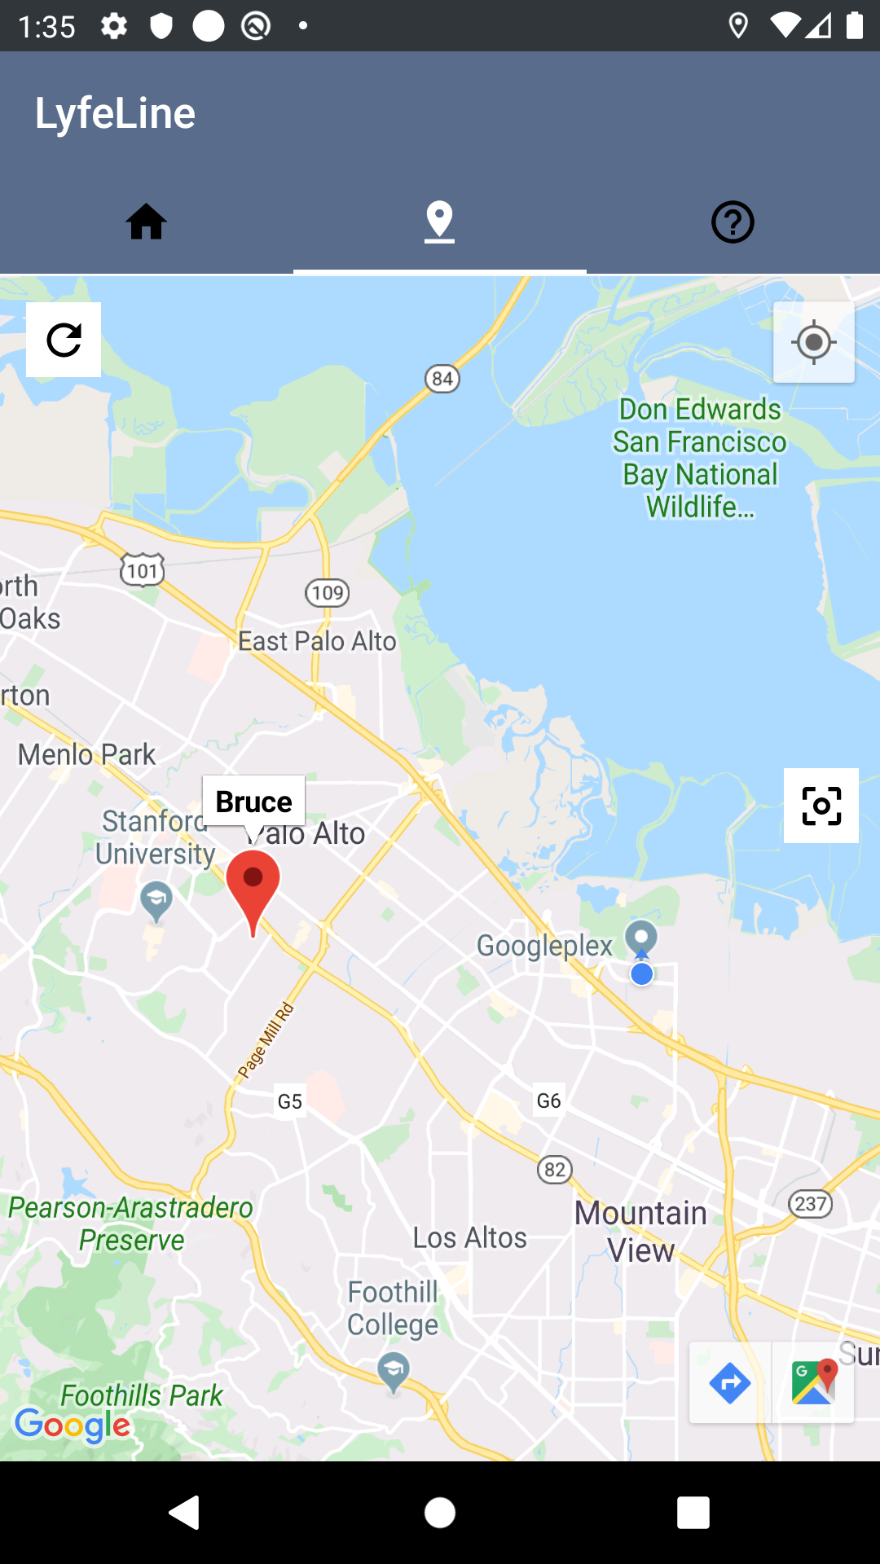
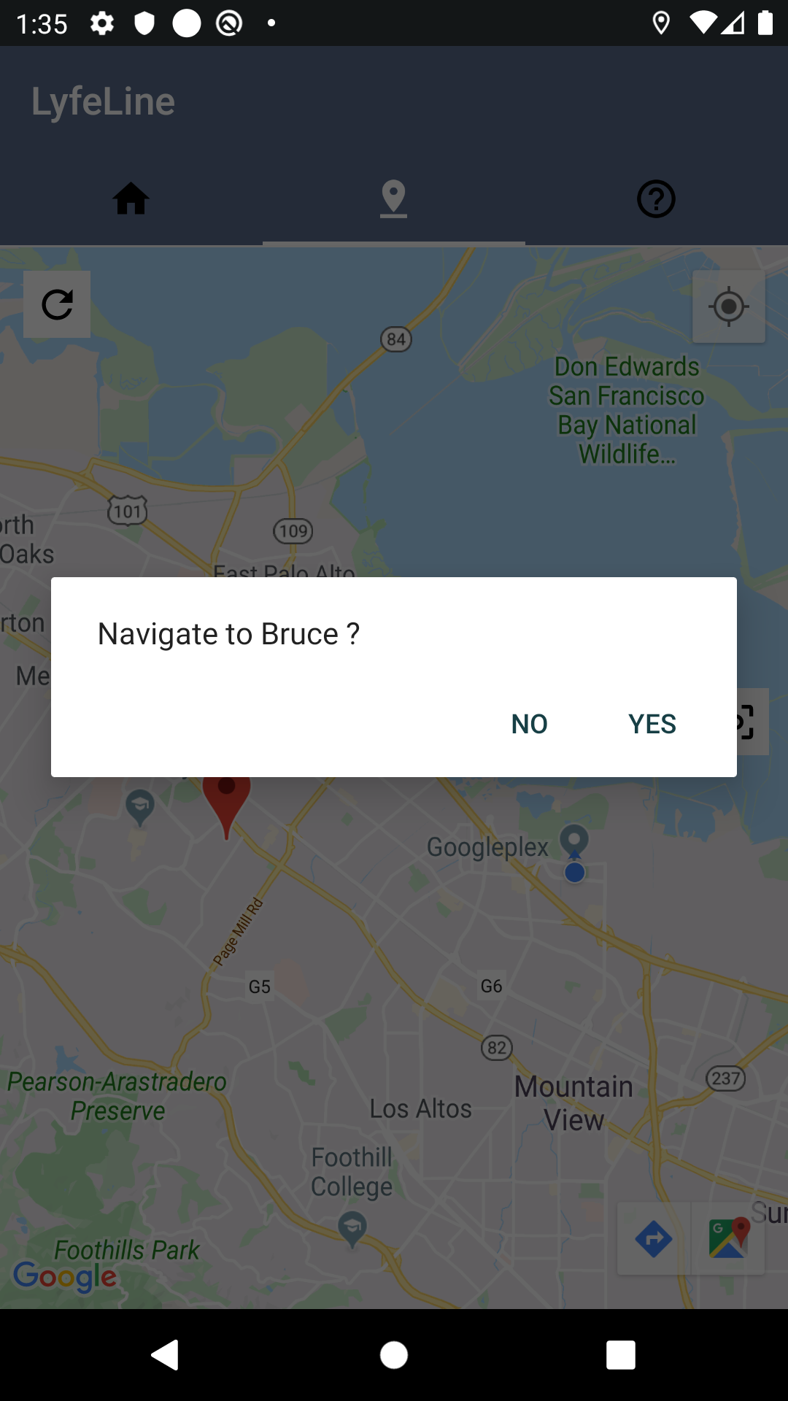
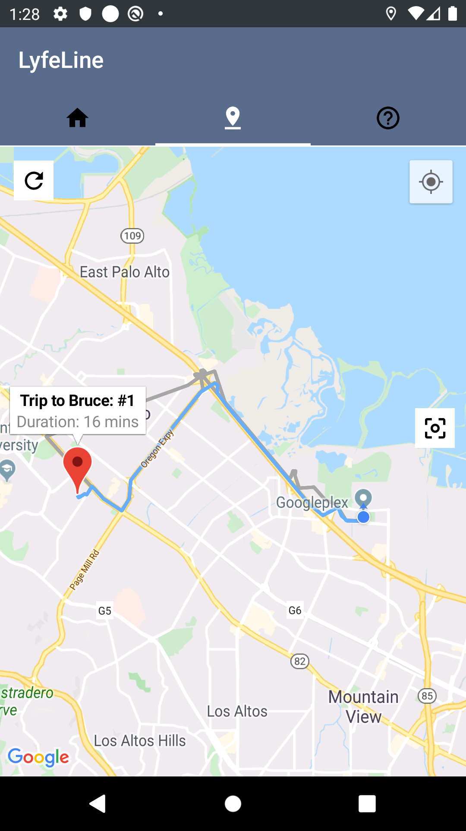
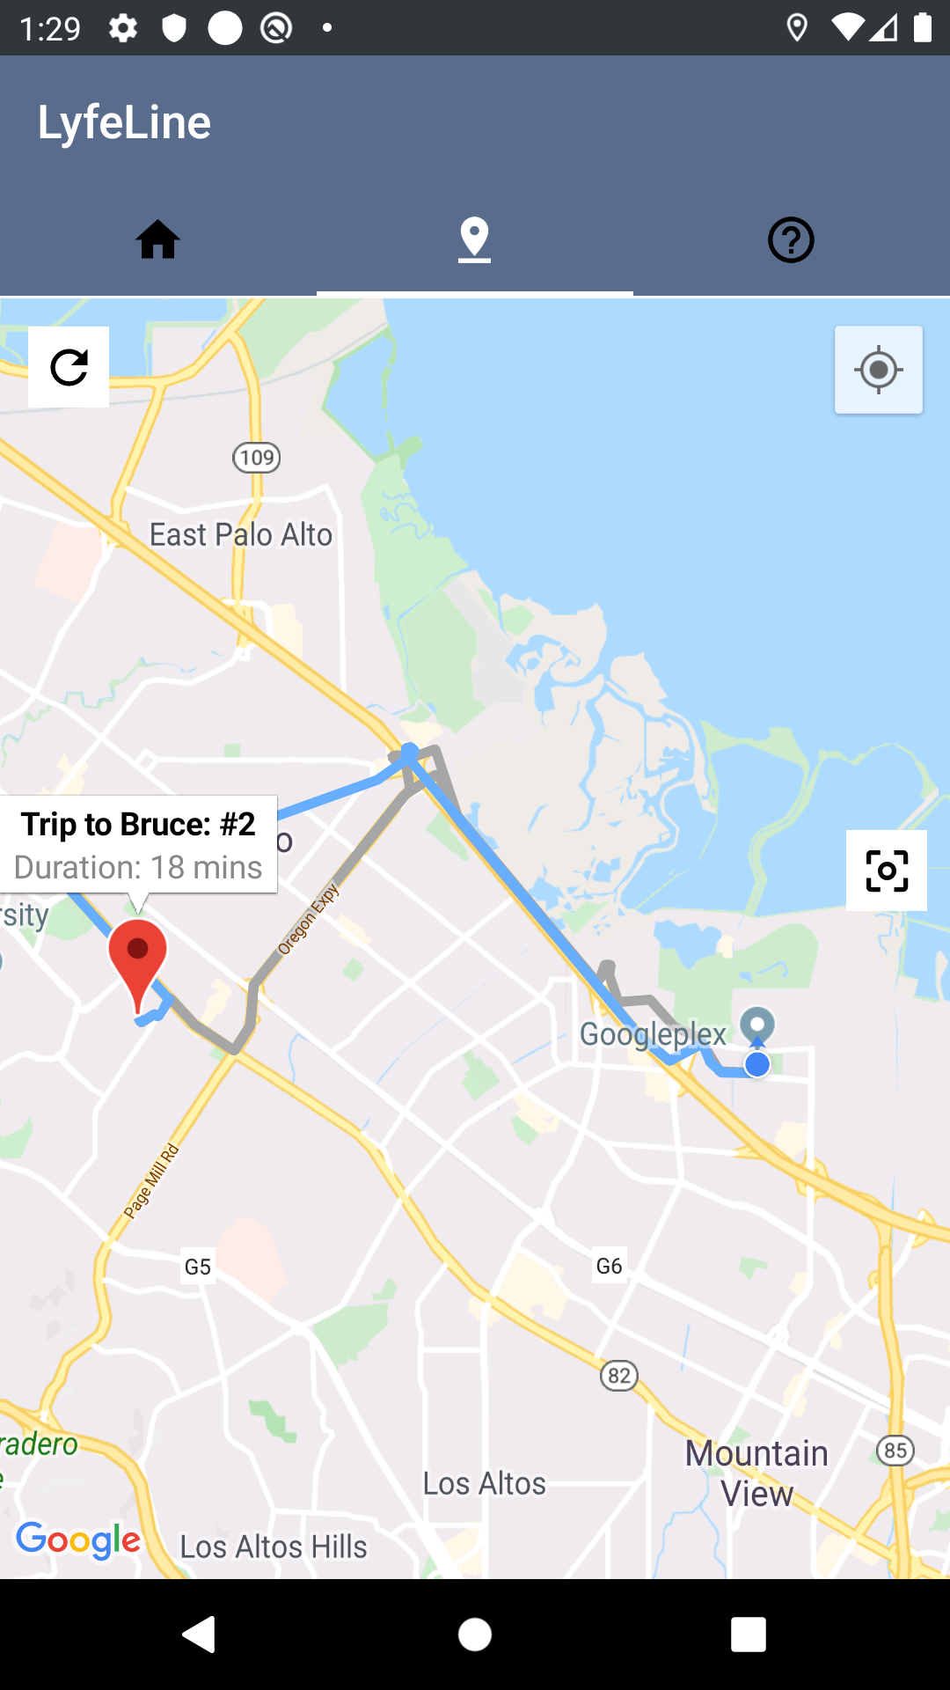
Directions
Fused Location Provider Client used to handle GPS/Wifi location, returns a Geopoint
Directions API takes an origin and destination, returns information needed to draw polylines on the map
Draw one polyline for each leg of the route
Find shortest duration and make it blue, or on click make it blue.

